Slide 1

Analyzing eCommerce Business Performance with SQL
Anees Bagus MPH, MBA
anees.bagus@gmail.com
https://www.linkedin.com/in/aneesabagus/
Data professional with abilities in analyzing and solving problems through data-driven decision-making. Proficient in Python, SQL, statistics, and various business intelligence tool with experience in project management.

Slide 2
Overview
In any company, measuring business performance is very important to track, monitor and assess the success or failure of various business processes. Therefore, we will analyze business performance for an eCommerce company, taking into account several business metrics, namely customer growth, product quality, and payment type.

Slide 3
Data Preparation
In this dataset there are 8 tables consisting of: orders, order_items, order_payments, order_reviews, customers, product, seller and geolocation
Import each table using the 'CREATE TABLE' query and confirm the values each column is given appropriate dtypes such as VARCHAR, INT, DATE, TIMESTAMP and FLOAT
Determine the primary key and foreign key with the query 'ALTER TABLE' on each the table
Forming ERD (Entity Relationship Diagram) as a result of importing tables into RDBMS postgreSQL

Slide 4
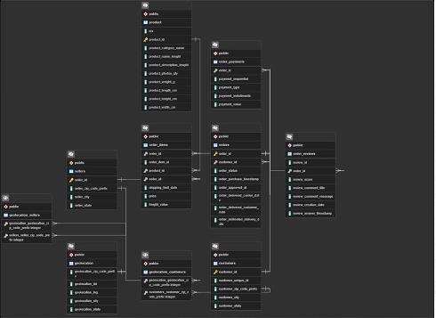
Data Preparation
Entity Relationship Diagram (ERD)

Slide 5
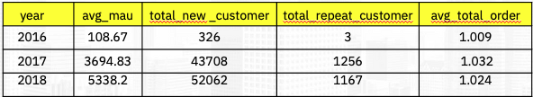
Annual Customer Activity Growth Analysis
Metrics used for Annual Customer Activity Growth Analysis:
avg_mau: average monthly active user (MAU) per year
total_new_customer: total new customers per year
total_repeat_customer: total repeat customers per year
avg_total_order: average total order per year

Slide 6
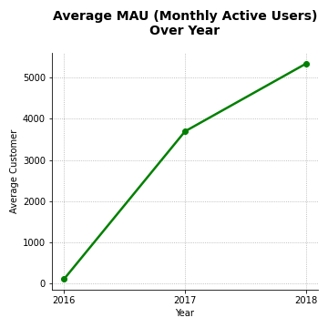
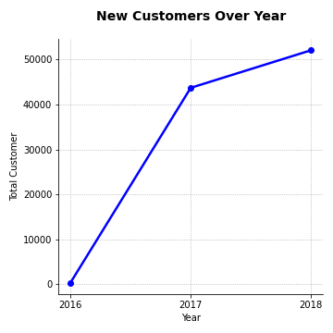
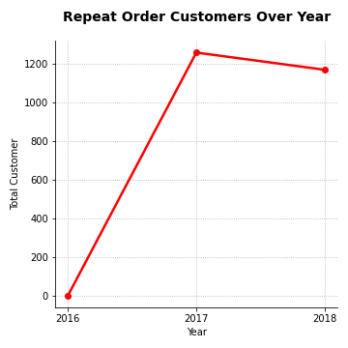
Annual Customer Activity Growth Analysis
avg_total_order metric is not significant, so it will not be used for evaluation
avg_mau has grown significantly over the last three years
total_new_customer has grown over the last three years, but growth slowed in 2018
total_repeat customer has grown over the least three years, and then decreased in 2018

Slide 7
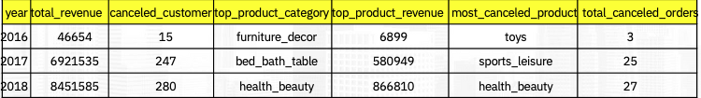
Annual Product Category Quality Analysis
Metrics used for Annual Product Category Quality Analysis:
total_revenue: total sales revenue per year
cancelled_customer: number of customers who cancelled orders per year
top_product_category: product category that sells the most per year
top_product_revenue: revenue for the product category that sold the most per year
most_cancelled_product: most cancelled product category per year
total_cancelled_orders: total number of cancelled transacations per year

Slide 8
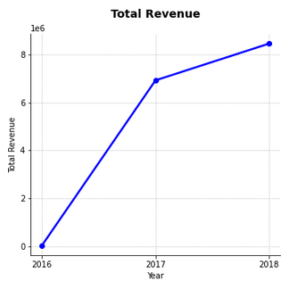
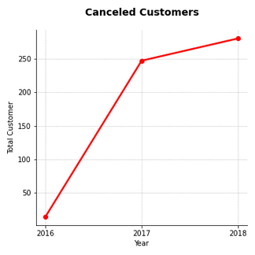
Annual Product Category Quality Analysis
Total revenue experienced significant growth over the last 3 years
The product category that had the highest revenue contribution in 2016 was furniture decor (6,899), in 2017 bed/bath/table (580,949) and in 2018 health & beauty (866,810)
The number of customers who cancel transactions is growing every year; 15 transactions in 2016, 247 transactions in 2017 and 280 transactions in 2018
The product categories that had the highest contribution of cancellations by customers in 2016 were toys (3 transactions), sports_leisure (25 transactions) and health_beauty (27 transactions)

Slide 9
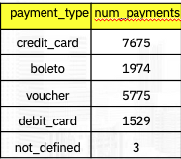
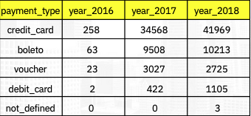
Analysis of Annual Payment Type Usage
Metrics used for Analysis of Annual Payment Type Usage:
payment_type: type of transaction used by customer
num_payments: total number of payments of all payment types
year_2016: total transactions of 2016
year_2017: total transactions of 2017
year_2018: total transactions of 2018

Slide 10
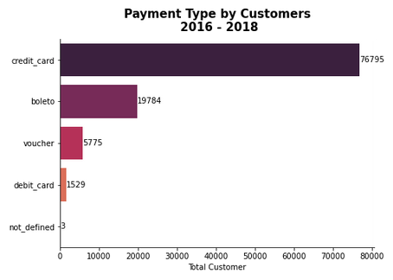
Analysis of Annual Payment Type Usage
The type of payment most used by customers in the last 3 years is credit card with a total transaction of 76,795.
Credit card payments are the most favored payment type by customers.
Other payment types used by customers in sequence are boleto (19,784 transactions), vouchers (5,775 transactions), and debit cards (1,529 transactions).
There were 3 transactions whose payment type was unknown in 2018

